Slide 1



Risk Management Dashboard_Nguyễn Đăng Vũ
View in Power BI
Last data refresh:
12/18/2022 5:53:33 PM UTC
Downloaded at:
1/8/2023 12:31:33 PM UTC

Slide 2
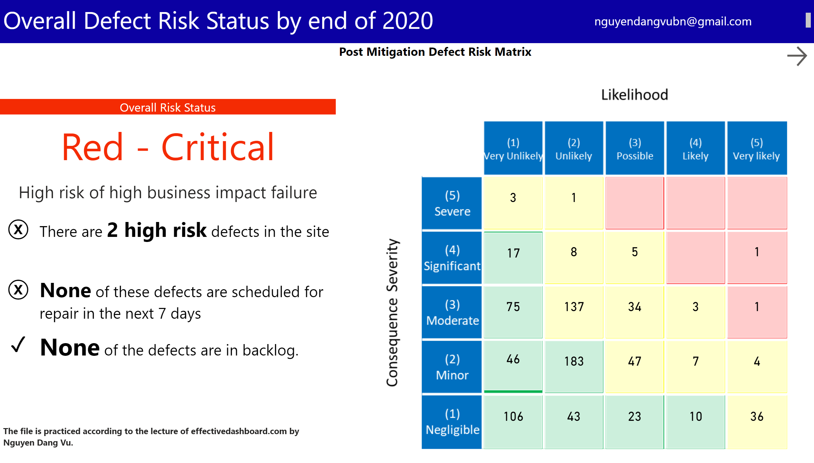
Overall Defect Risk Status
Notes:
Post Mitigation Defect Risk Matrix
No alt text provided
enlightenDataStoryDDFB78A6143E42CFAFBC50CCF18D978D
No alt text provided
enlightenDataStoryDDFB78A6143E42CFAFBC50CCF18D978D
No alt text provided
enlightenDataStoryDDFB78A6143E42CFAFBC50CCF18D978D
No alt text provided
enlightenDataStoryDDFB78A6143E42CFAFBC50CCF18D978D
No alt text provided
enlightenDataStoryDDFB78A6143E42CFAFBC50CCF18D978D
No alt text provided
enlightenDataStoryDDFB78A6143E42CFAFBC50CCF18D978D
No alt text provided
card
No alt text provided
Overall Risk Status
No alt text provided
textbox
No alt text provided
actionButton
No alt text provided
textbox
No alt text provided
textbox
No alt text provided

Slide 3
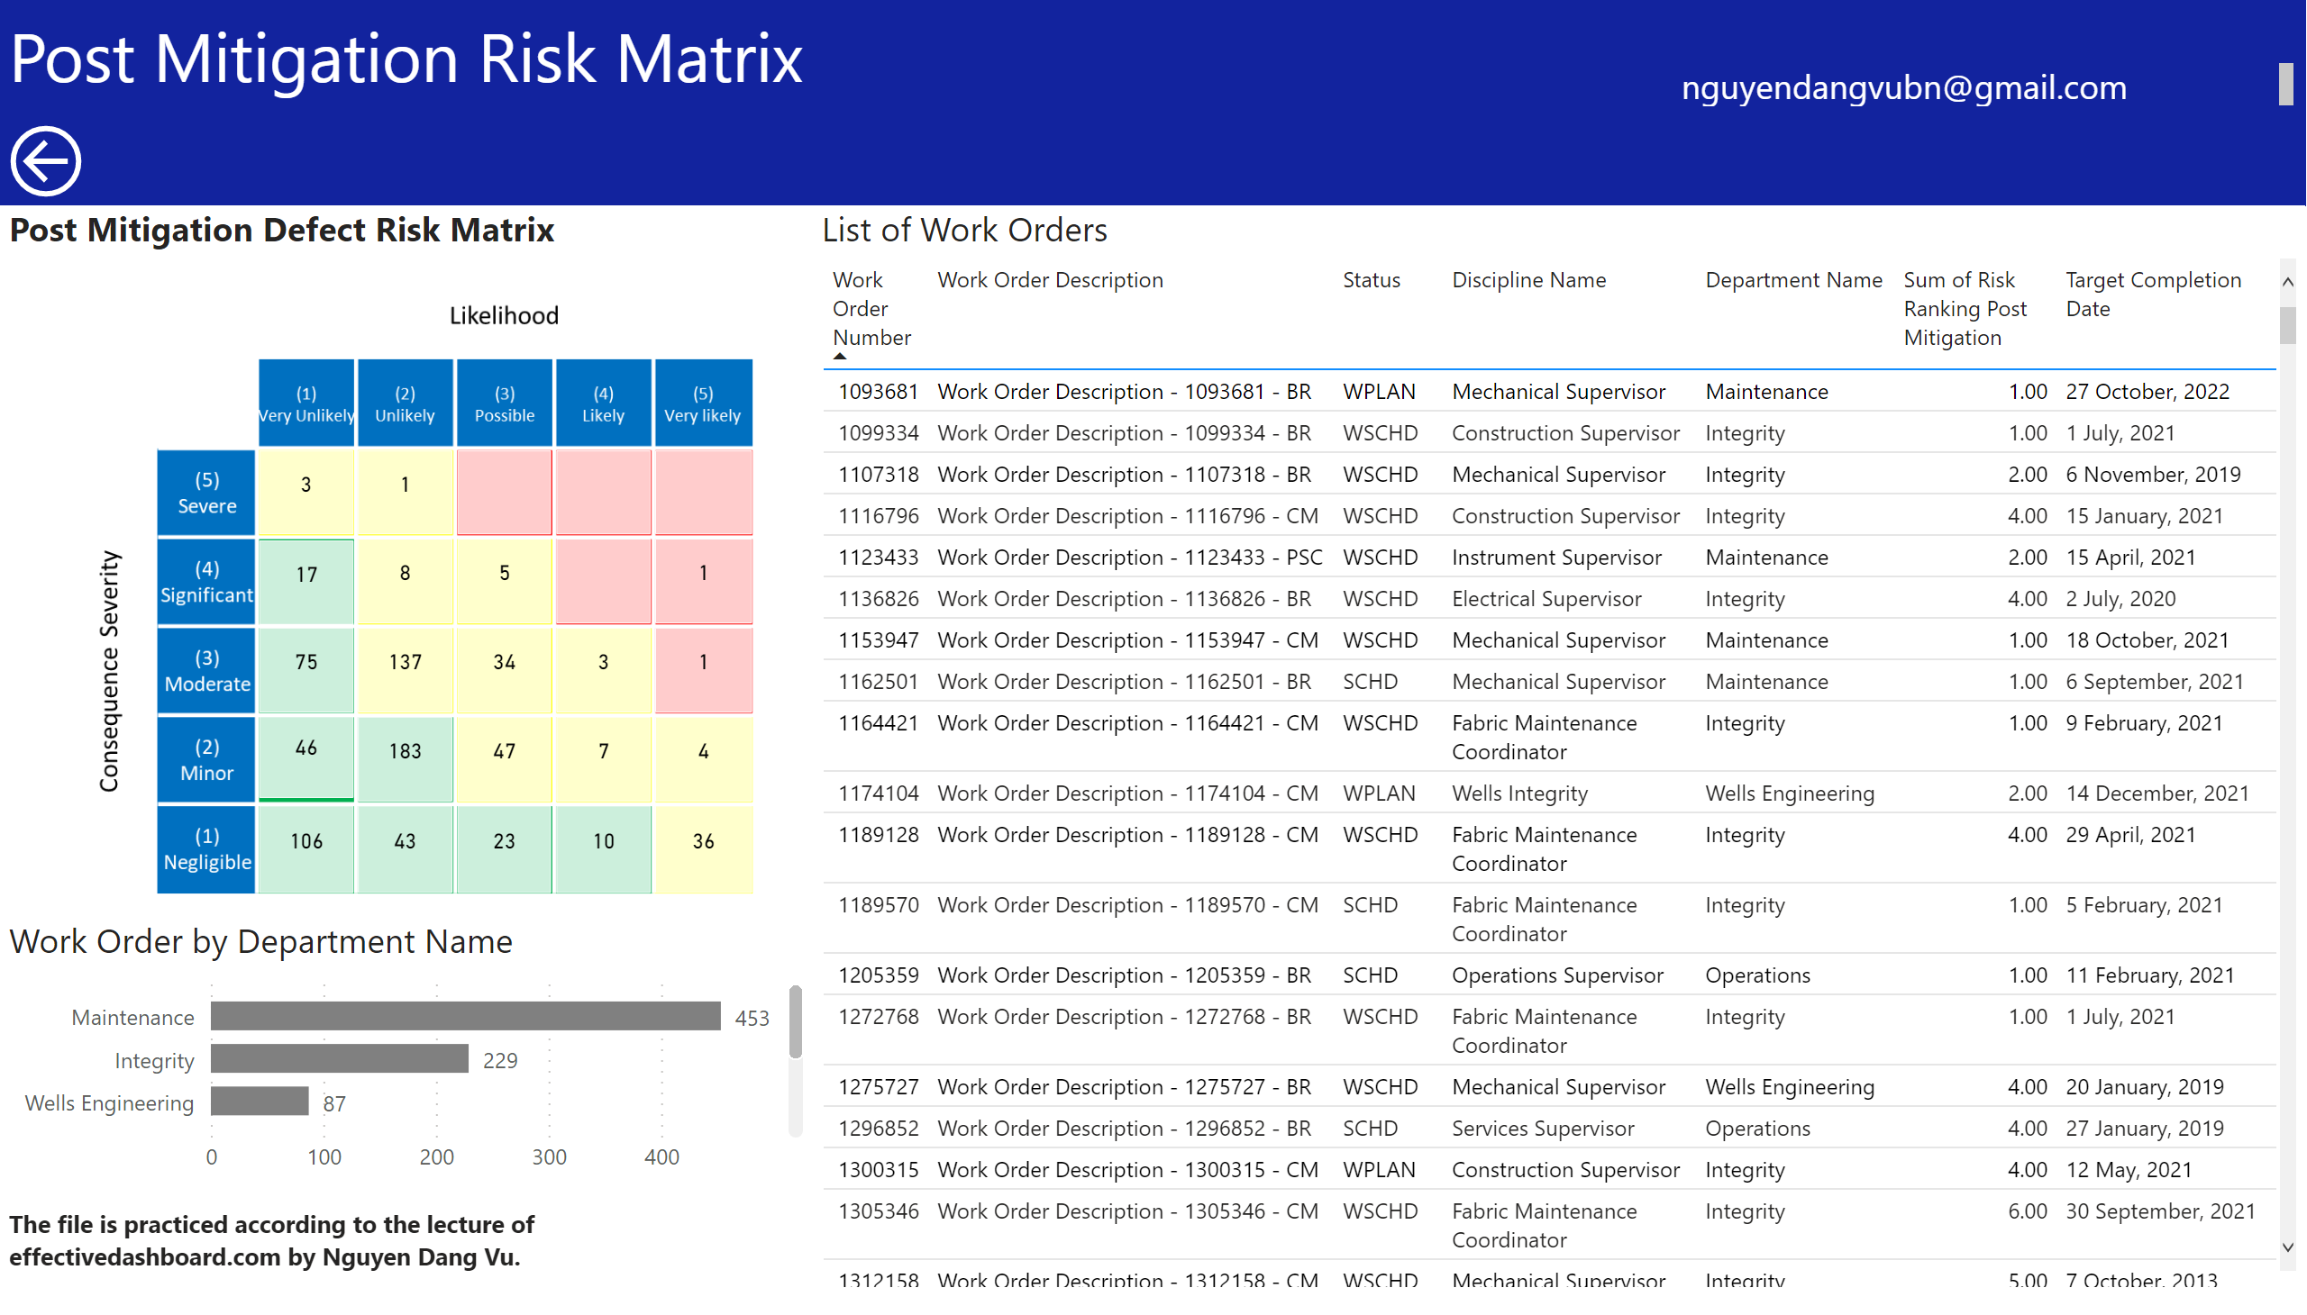
Work Orders
Notes:
Work Order by Department Name
No alt text provided
List of Work Orders
No alt text provided
Post Mitigation Defect Risk Matrix
No alt text provided
textbox
No alt text provided
actionButton
No alt text provided
textbox
No alt text provided
textbox
No alt text provided

Slide 4
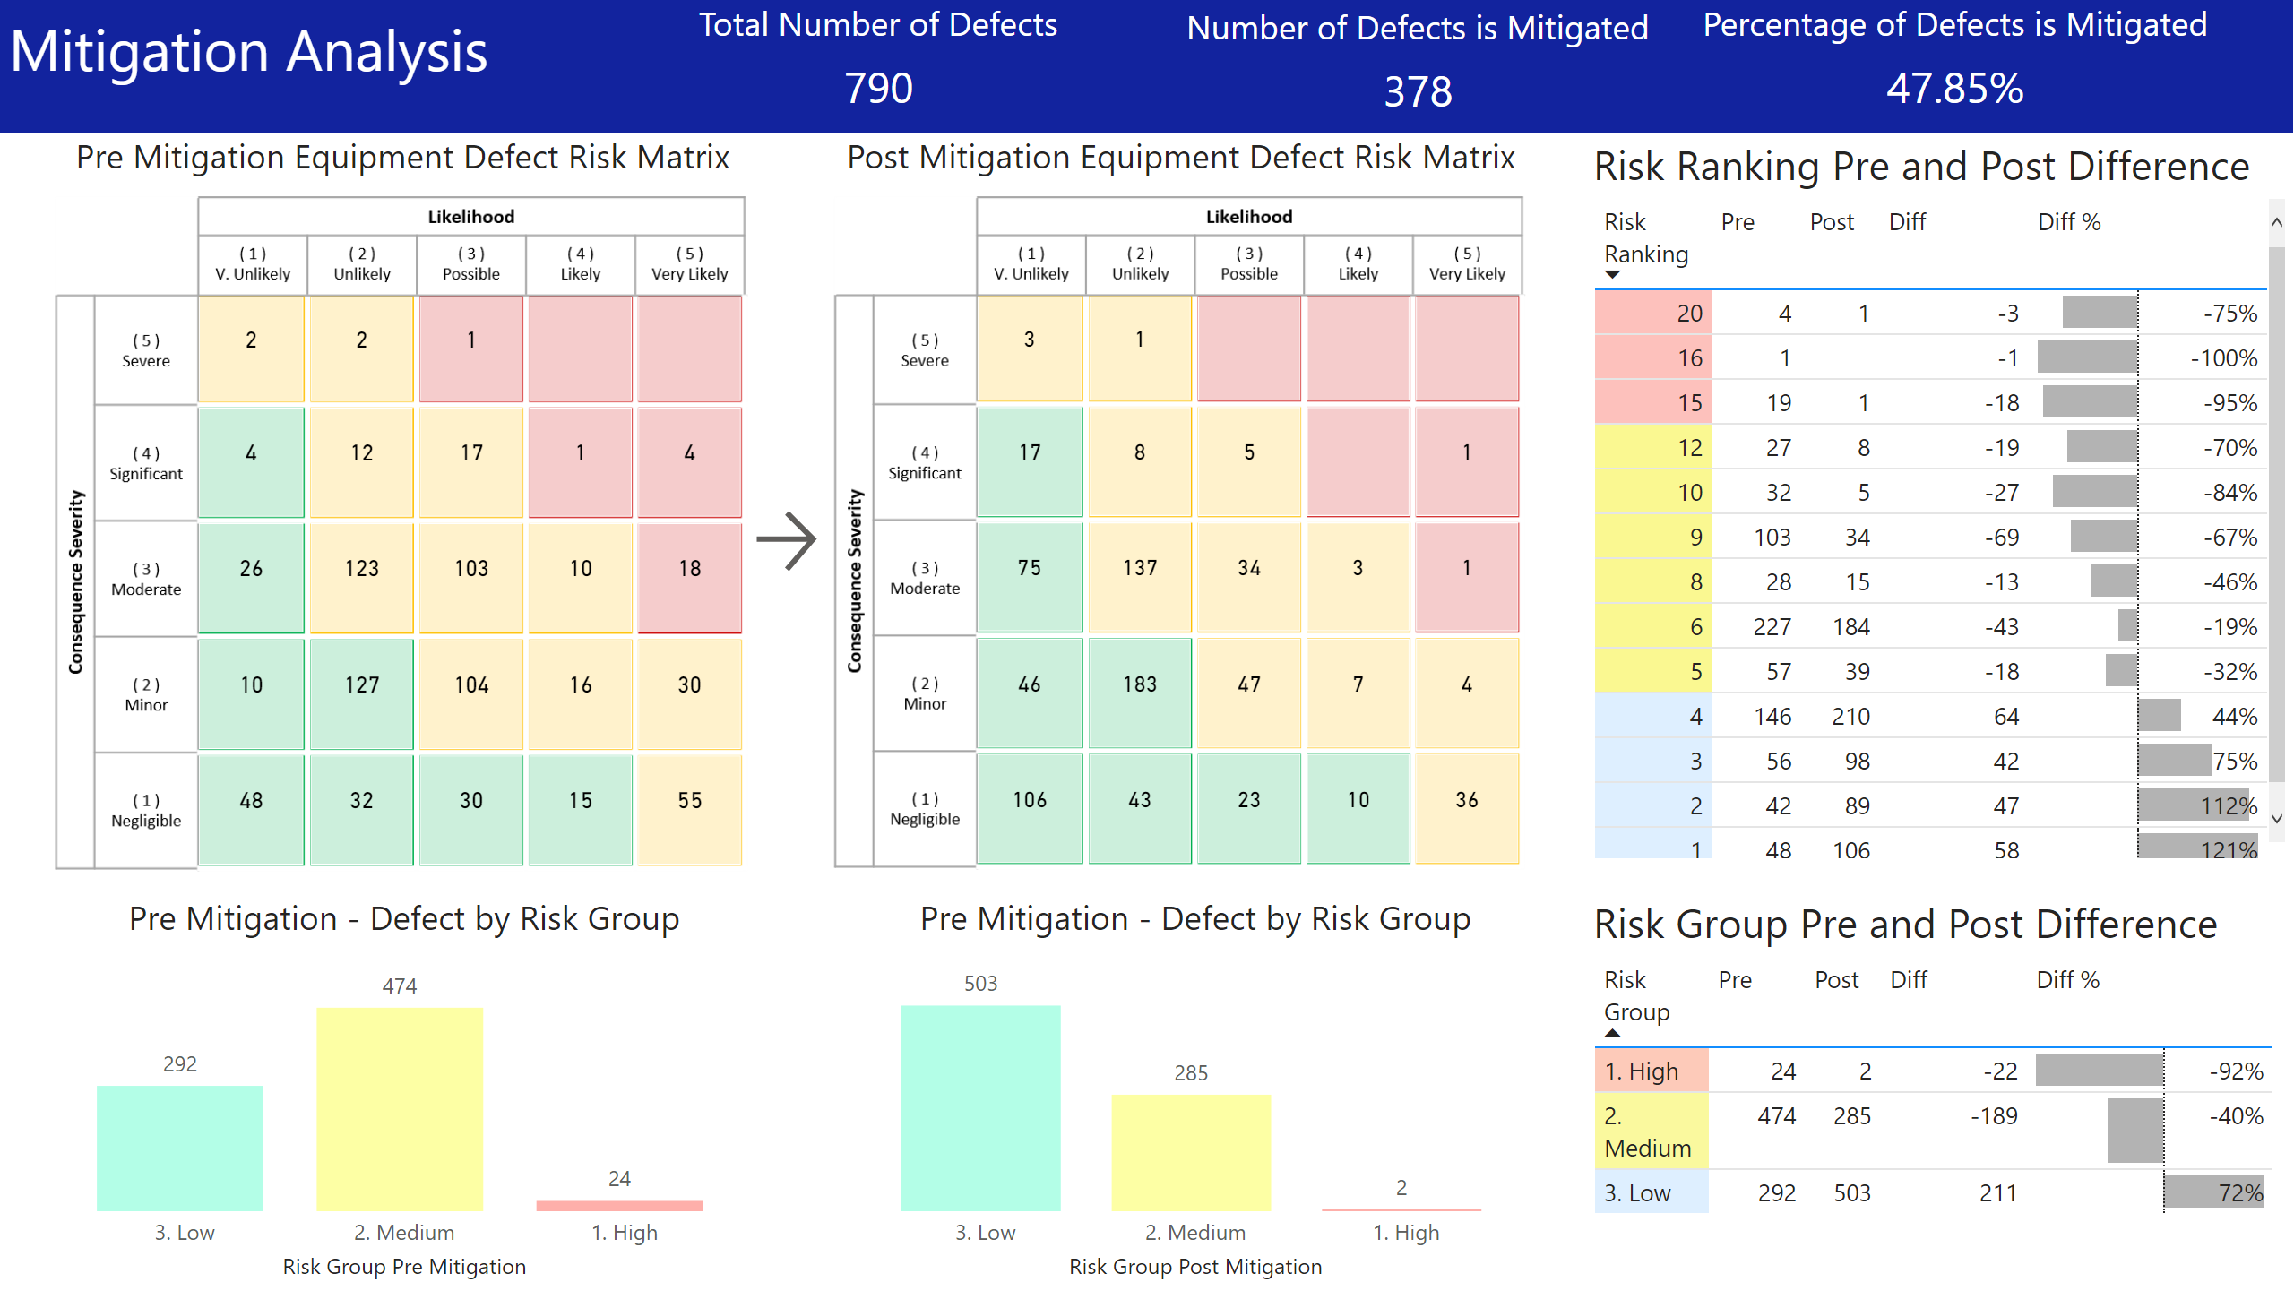
Mitigation Analysis
Notes:
actionButton
No alt text provided
Post Mitigation Equipment Defect Risk Matrix
No alt text provided
textbox
No alt text provided
Total Number of Defects
No alt text provided
Number of Defects is Mitigated
No alt text provided
Risk Ranking Pre and Post Difference
No alt text provided
Percentage of Defects is Mitigated
No alt text provided
Risk Group Pre and Post Difference
No alt text provided
actionButton
No alt text provided
Pre Mitigation - Defect by Risk Group
No alt text provided
Pre Mitigation - Defect by Risk Group
No alt text provided
Pre Mitigation Equipment Defect Risk Matrix
No alt text provided

Slide 5
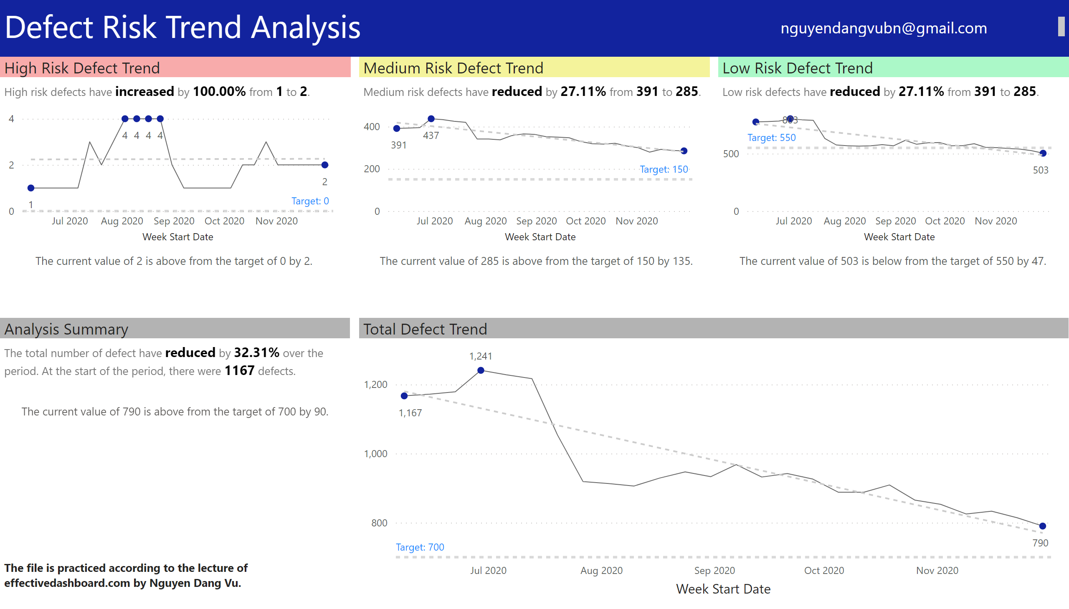
Risk Trend
Notes:
High Risk Defect Trend
No alt text provided
Medium Risk Defect Trend
No alt text provided
Low Risk Defect Trend
No alt text provided
textbox
No alt text provided
Total Defect Trend
No alt text provided
High Risk Defect Trend
No alt text provided
Medium Risk Defect Trend
No alt text provided
Low Risk Defect Trend
No alt text provided
Analysis Summary
No alt text provided
actionButton
No alt text provided
actionButton
No alt text provided
actionButton
No alt text provided
actionButton
No alt text provided
textbox
No alt text provided
textbox
No alt text provided

